Slide 1
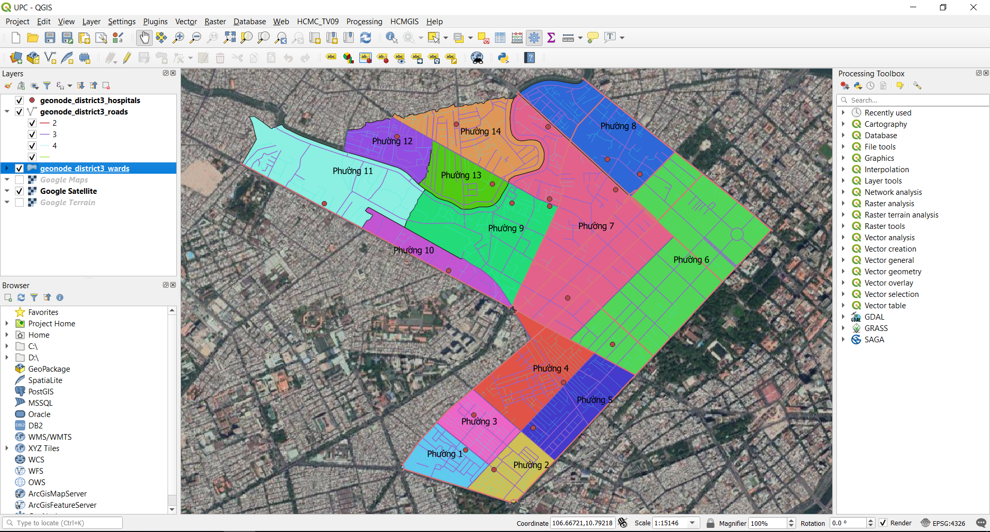
Unit 2: Working with Vector Data

Slide 2
Working with Vector Data
File and data types: Shapefile, CSV, GeoPackage, SpatiaLite, PostGIS, MSSQL, Oracle, DB2, WMS, XYZ Tiles, WFS, ArcGIS Mapserver, GeoNode
Loading Data: Add tool, QGIS Browser, reordering layers
Layer Properties: Symbology (Single Symbol, Categorized Symbol), Label
Adding AutoCAD, MicroStation Files
Working with Layer Attribute: view/ sort attribute, select feature by expressions, add/ remove fields, calculate field
Export layer, convert geometry type

Slide 3
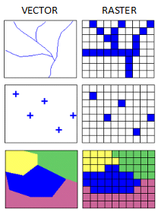
GIS Data model
GIS Data model: Vector vs Raster
Characteristic | Vector | Raster
Data structure | Point, line (connected points) and polygon (closed line) Represents POI, Street, administrative border,… | AKA grid data (a regular grid of cell/ pixel) → represents continuous surfaces (digital photograph, satellite image, elevation surface,…)
Storage | Small | Large
Display and output | Map-like, smooth | Good for images, but discrete features may show “stair-step” edges Different scales between layers can be a nightmare May lose information due to generalization

Slide 4
File and data type
Most used data format:
Vector: Shapefile, geojson, geopackage
Raster:
Georeferenced: Geotiff
Non-georeferenced: .jpg, .png,..
GRID
Tabular (Attributes):
Spreadsheets: .xls, .dbf
Combined vector/raster/tabular:
ESRI GeoDatabase
DBMS (PostgreSQL/PostGIS, SQLite/ SQLSpatial, MySQL, MSSQL, Oracle, DB2,…)

Slide 5
Shapefile
Shapefile:
A simple, nontopological format for storing the geometric location and attribute information of geographic features.
Developed and regulated by Esri, requires at least three files to define one spatial layer.
Only support column names <= 10 characters
Only supports homogeneous spatial types for each layer (point/ line/ polygon)
Only supports text fields of up to 255 characters
File size limit at 2GB

Slide 6
Shapefile
Shapefile:
03 mandatory files:
*.shp: shape (point, line or polygon)
*.shx: shape index (search optimization)
*.dbf: attribute (dBASE file, can open in Microsoft Access or Excel)
Optional files:
*.prj: coordinate and projection system information
*.cpg: code page (should be ‘UTF-8’ for Vietnamese Unicode)
*.xml: metadata
*.sbn /*.sbx: spatial index that speed up loading times and optimizes spatial queries
In QGIS: *.qpj store coordinate and projection system information for on the fly projection

Slide 7
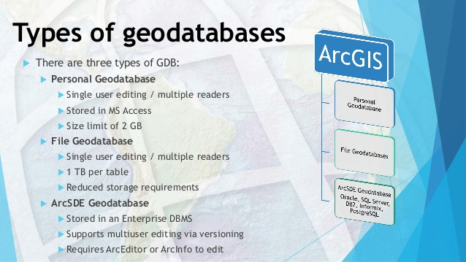
Shapefile
ESRI Geodatabase

Slide 8
Shapefile
GeoPackage:
Defined by Open Geospatial Consortium (OGC)
Open Standard, widely used in the open source world
A “shape file replacement” format
Use open souce SQLite (file-base DBMS) as the storage engine
Stores data in a single file
Support both vector/ raster (or tiled raster) data

Slide 9
File and data types
Other format:
CSV (comma-separated values): Text file
GeoJSON
DBMS: SpatiaLite (file-based DBMS), PostGIS, MSSQL, Oracle, DB2
Web Map Service: WMS, XYZ Tiles, WFS, ArcGIS MapServer, GeoNode

Slide 10
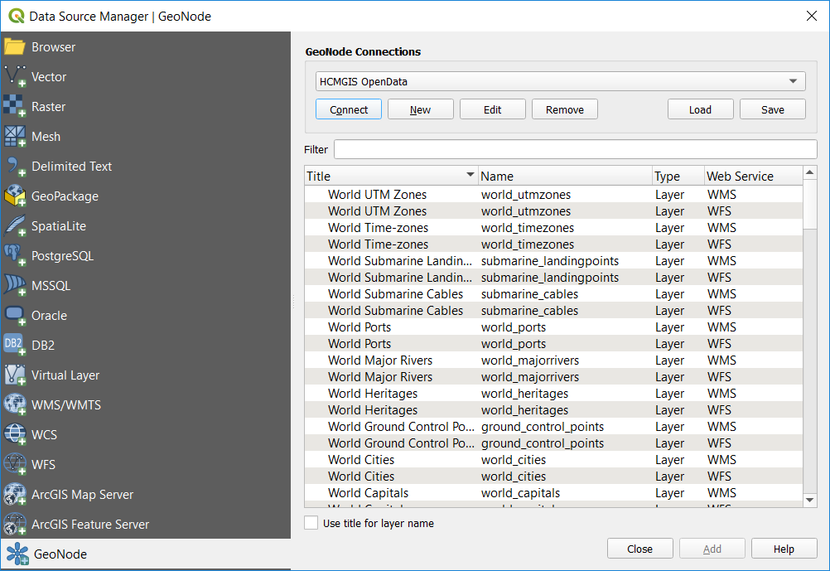
File and data types
3 ways to Add data into QGIS
Layer → Add layer
Open Data source Manager
Drag and drop from QGIS Browser or Window Explorer (Add to favorites for frequently used data)

Slide 11
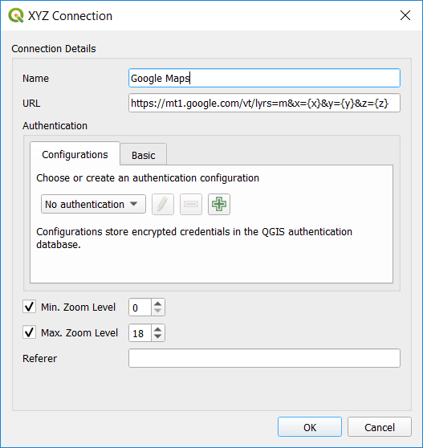
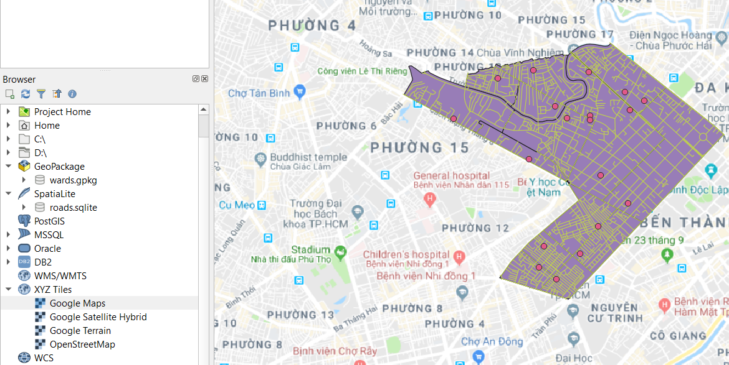
File and data types
Add XYZ Tile basemap
Google Maps: https://mt1.google.com/vt/lyrs=m&x={x}&y={y}&z={z}
HCMGIS Aerial Images: https://trueortho.hcmgis.vn/basemap/cache_lidar/{z}/{x}/{y}.jpg

Slide 12
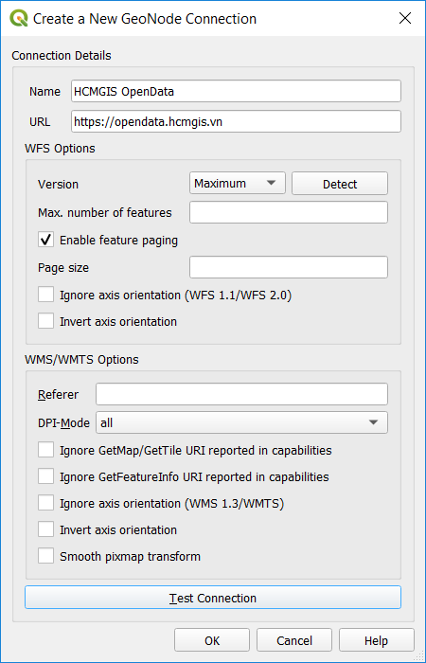
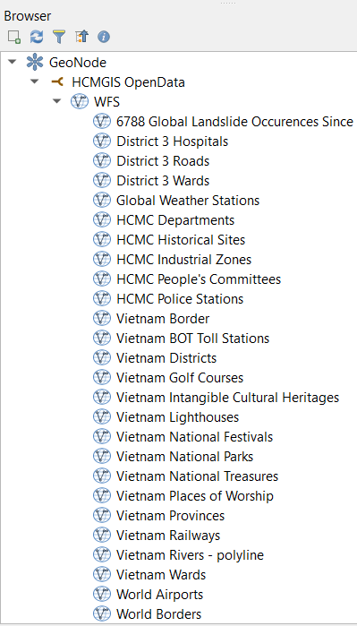
File and data types
Add data from Geonode:
URL: https://opendata.hcmgis.vn

Slide 13
Add AutoCAD file
Add AutoCAD/ MicroStation files:
The same way with other file formats
Export to shapefile and other formats
Convert geometry type:
Line <--> Polygon
Polygon → Point (Nodes/ Centroid)
Line → Point (Nodes/ Centroid)

Slide 14
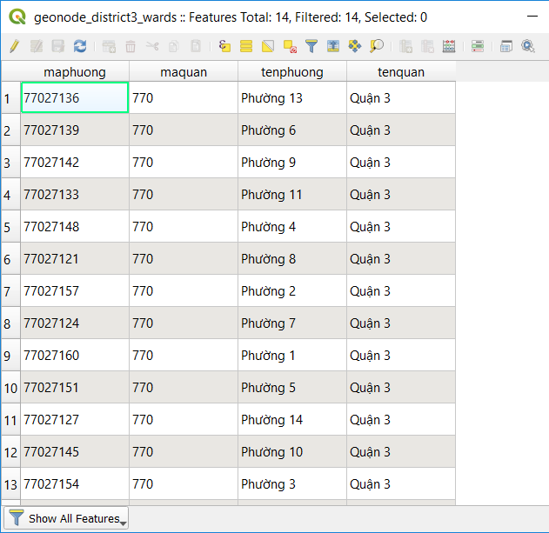
Working with Attribute Table
View/ sort attribute
Filter by value
Select feature by expressions
Add/ remove fields
Calculate field

Slide 15
Select feature by Expression
QGIS supports SQL-like expressions (for number, string and column reference).
Some basic operators:
Comparison operators: operators that compare values and return True (1) or False (0) (Boolean values)
a = b a and b are equal
a > b a is larger than b
a < b a is smaller than b
a <> b a and b are not equal
a != b a and b are not equal
a <= b a is less than or equal to b
a >= b a is larger than or equal to b

Slide 16
Select feature by Expression
Logical operators: operators that combine multiple boolean expressions or values and provide a single boolean output (True/ False or 1/0):
A and B: returns True when both A and B are True
A or B: returns True when A or B is True
not A: returns True if A is False and vice versa
A | B | A and B | A or B | not A
0 | 0 | 0 | 0 | 1
1 | 0 | 0 | 1 | 0
0 | 1 | 0 | 1 | 1
1 | 1 | 1 | 1 | 0

Slide 17
Some basic Operators
Calculation operators:
a + b a plus b
a - b a minus b
a * b a multiplied by b
a / b a divided by b
a % b a modulo b: the remainder of a divided by b (7 % 2 = 1)
a ^ b a power b (for example, 2^2=4 or 2^3=8)
() parentheses - for enforcing the operator precedence:
(1 + 1) * 3 = 2*3 = 6
unary plus and minus: -12, +5

Slide 18
Some basic Operators
Mathematical functions: sqrt, sin, cos, tan, asin, acos, atan
Conversion functions: to_int, to_real, to_string, to_date
Geometry functions: $area, $length
Geometry handling functions: $x, $y, $geometry, num_geometries, centroid

Slide 19
Some basic Operators
|| | joins two values together into a string: E.g: 'Hello' || ' world’ = ‘Hello World’
Pattern matching: LIKE (using wild card character % (zero or more characters) or _ (zero or one character),) | returns 1 if the string matches the supplied pattern: E.g: “field” like ‘…%’…
"column name" (quotation marks/ double quote) | value of the field column name
‘string’ (apostrophe/ single quote ) | a string value
NULL value checking: IS NULL, IS NOT NULL | E.g: “field” is null
IN | E.g: 1 in (1,2,3,4) return True

Slide 20
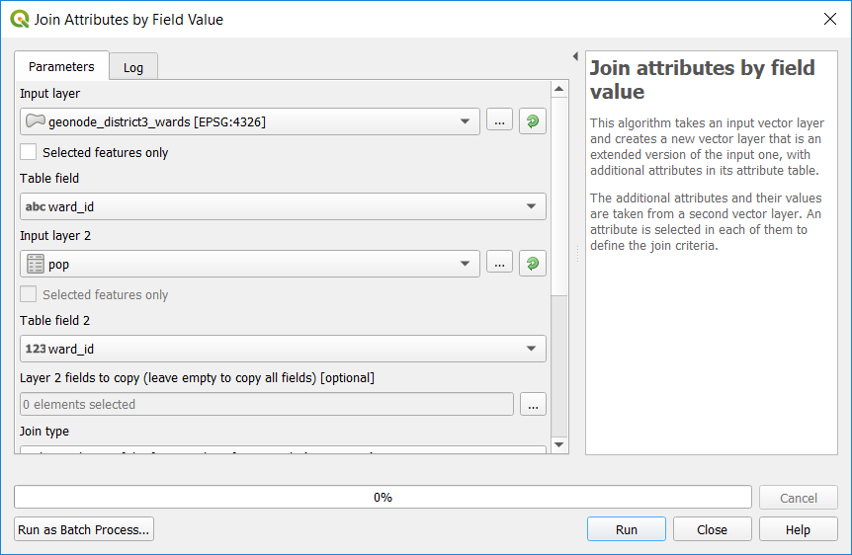
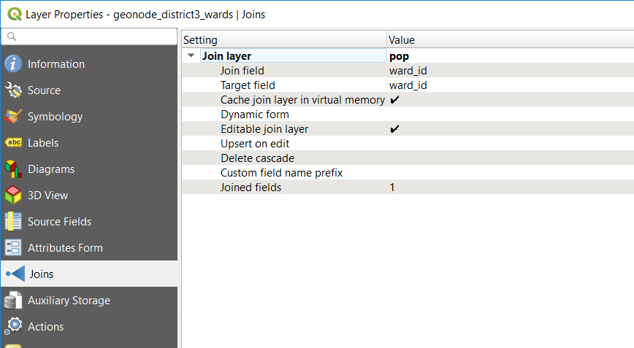
Join Attributes by Field Value
Use “Joins” in Layer Properties: just for view only
Use “Join Attributes by Field Value”: create a new Shapefile

Slide 21
Exercises
Exercises:
Drag and drop shapefile into QGIS using Window Explorer or QGIS Browser
Show feature count, symbology, labeling, set CRS
Export Layer
Add geopackage/ GeoJSON/ Geonode data, XYZ Tiles Basemap
Calculate Field: Calulate Polpulation Density
Join “Wards” Shapefile with pop excel → create a new Wards_pop Layer
Create a new Field named “density”
Calculate Population Density into “density” colum: Pop/ Area (km2)

Slide 22
Some advanced Tool
Decoration
Preview Mode
Toggle Panel, Map
Show New Map View
Working with Bookmarks: Create, Show, Import, Export
Show Statistical Summary
Measure Distance
Action
Map tips
Evis Plugin
Export Map to Image, PDF

Slide 23
Keep Calm and enjoy Learning!
https://hcmgis.vn
HCMGIS – GIS for the City, GIS for the Community

